Slide 1
Amended Returns Prior Year Returns
Pub 4012 – Tab M Pub 4491 – Lesson 33
Notes:
Release 2 Slide changes:
#12 – Added note
#21 – Added note
#27 – Clarification added of "information only"
Entire lesson comprehensive

Slide 2
Reasons to Amend
Something reported incorrectly or omitted from original return
New or corrected information received by taxpayer
Should or could have used a different filing status
Mistakes
Omissions
Notes:
2
Generally, an amendment is requested by taxpayer

Slide 3
Reasons to Amend
Received additional or corrected income statement not reported on original return
Claimed personal exemption in error
Claimed deductions or credits in error
Eligible deductions or credits not included on original return
Notes:
New information
Late W-2 or 1099 received, omitted from original return
Changed information
“Corrected” W-2 or 1099
Error
Wrong filing status
Filed single w/dependent and should have been head of household
Claiming a dependent in error
Claimed a credit or missed a credit

Slide 4
Reasons to Amend
Married individuals originally filing MFS, HoH, Single, or QW may amend to MFJ if eligible
Up to three prior year returns
Must be legally married as of December 31 year amending
Married individuals may not amend MFJ to MFS
After original filing deadline
Notes:
Same sex couples that filed single/HoH/QW May amend, but are not required
If filed MFJ and return accepted before April deadline, you can amend to MFS and mail 1040x before to April 15th. If both taxpayer and spouse do not amend, IRS will send letters to both.
After April filing deadline, cannot amend MFJ to MFS

Slide 5
Do Not Amend
Do not amend return if
Math errors
IRS will correct them
IRS has requested taxpayer provide missing schedules/forms
Taxpayer should respond per notice
Notes:
Do not need to amend return only to respond to IRS notice. May want to amend for other reasons but amending to agree with IRS notice is not necessary.
Math errors using tax software rare ... but possible.

Slide 6
Tax-Aide Certification to Amend
Counselors must be certified for year amending
Additional certified counselor needed for QR
Amended returns must be mailed to IRS
Can amend returns for current and previous three years only
State may also need amendment
Notes:
Counselors can also prepare prior year returns if certified in year requested. Remember, must have additional certified counselor available to QR.

Slide 7
Amended Returns
Returns amended on Form 1040X
Begin 1040X with numbers from most recent filing
Form 1040 or
As adjusted by IRS or
Previously filed 1040X
Notes:
You can amend return even if refund not received or balance due not paid. Wait to mail 1040X until return processed by IRS – approximately 4 weeks

Slide 8
Statute of Limitations – Refund
Taxpayers time to file for refund later of:
3 years from original due date or actual date filed if later
2 years from date tax was paid
State statute may differ
Exceptions to this statute are out of scope
Notes:
The regular statute for 2013 ended April 18, 2017 (originally due 4/15/2014 plus 3 years)
There are longer statutes for some items, such as claiming a loss on worthless securities or foreign tax credit. These taxpayers should be referred to a paid preparer

Slide 9
Statute of Limitations – Balance Due
Taxpayers owing additional tax
IRS barred by statute of limitation from assessing additional tax
3 years from original due date or date filed if later
No limitation if fraud involved
3 year statute of limitation does not apply if return never filed
Notes:
No statute to voluntarily amend and pay more tax

Slide 10
Interview
Review return to be amended
Review that year’s Intake Form or Booklet
Verify amended return necessary
Verify IRS changes or notifications
Confirm and note all changes needed on Intake Booklet
Notes:
The IRS communicates with the taxpayer by letter

Slide 11
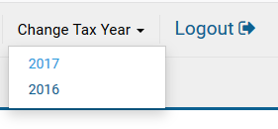
Amending in TaxSlayer
Must use TaxSlayer Form 1040X in the year amending
Amending 2015, use 2015 TaxSlayer software
Choose which year you need from Change Tax Year dropdown list
If original return recently e-filed
Wait until IRS processes original return before submitting amended return
Notes:
IRS processes e-filed return in about four weeks

Slide 12
Amending in TaxSlayer: Example
Original return:
W-2: $35,000
1099-INT: $75
Federal withholding: $4,000
Filing Status: Single – Exemption: $4,050
Standard Deduction (over 65): $7,900
AGI: $35,075 – Tax: $3,003
Refund: $997
Taxpayer receives additional 1099-INT for $100 after 2017 return e-filed and accepted
Notes:
2017 return
$100 additional 1099-INT income, while “small”, must be included in income (1040X, if necessary) to prevent additional IRS correspondence.

Slide 13
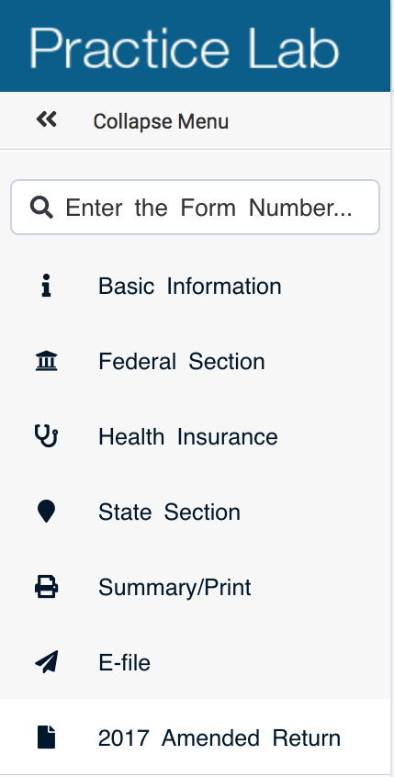
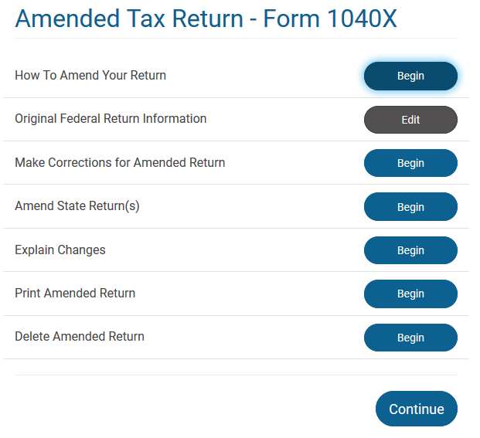
Amending in TaxSlayer
Notes:
If taxpayer’s return prepared at same site, select 2017 Amended Return for left menu in TaxSlayer
If taxpayer’s return prepared at different site, enter Basic Information from original return: filing status, personal information and dependent information – then go to 2017 Amended Return
You can print the Form 1040X anytime. Click on Print Amended Return. This is a useful check to see what is actual in TaxSlayer as you update the Original Federal Return Information step. If you do not see the correct information in Column A, then fix in Columns A and C before proceeding.
How to Amend Your Return includes instruction – good information

Slide 14
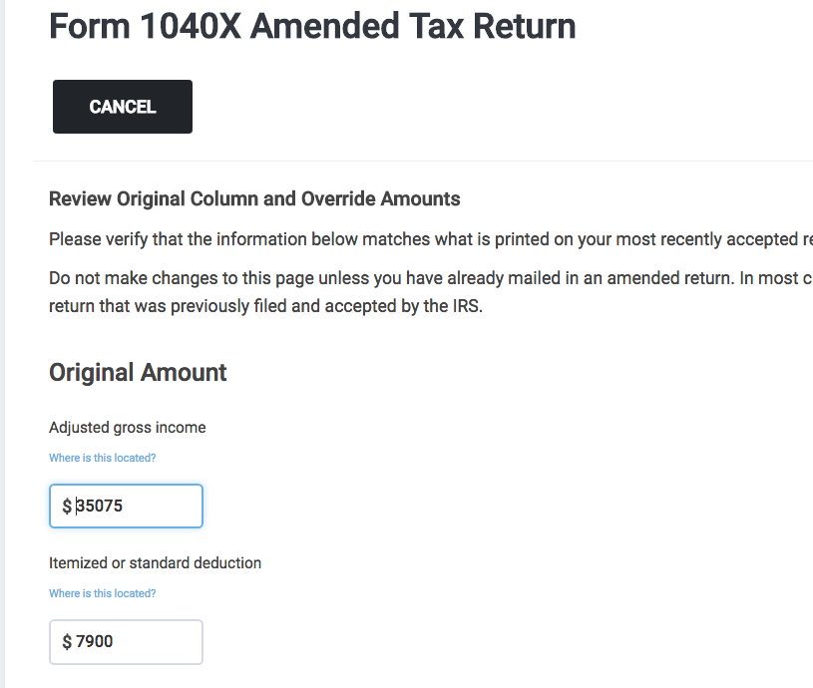
Amending in TaxSlayer
If not prepared at same site, enter requested information
Notes:
If the return was prepared and IRS accepted at the same site, all information will carry forward and populate on the 1040X. Verify the amounts are correct.
If the return was not prepared at your site, enter the requested information from taxpayer’s original return.
Again, you can verify the Original amount (Column A) by clicking “Print the Amended Return” anytime in the process.

Slide 15
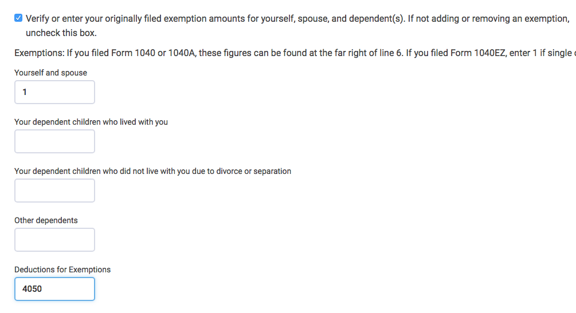
Amending in TaxSlayer
Do not uncheck exemption verification box
Enter original number of exemptions and amount even though you are not changing the number of exemptions
Notes:
Select continue once all entries have been verified

Slide 16
Amending State Returns
State amended returns depend on Federal information
Important: Verify and match original state return information before making corrections to the federal
Open and “set” state amendment form prior to making corrections to federal return
Notes:
The TaxSlayer amendment process can make life miserable for making and correcting amendment state returns that are dependent of Federal income and deductions.
“Make Corrections for Amended Return” TaxSlayer step may adversely impact the state starting point.
Solution: start the Column A and C in the state amended return before the making changes to the (Column B in the Federal return.

Slide 17
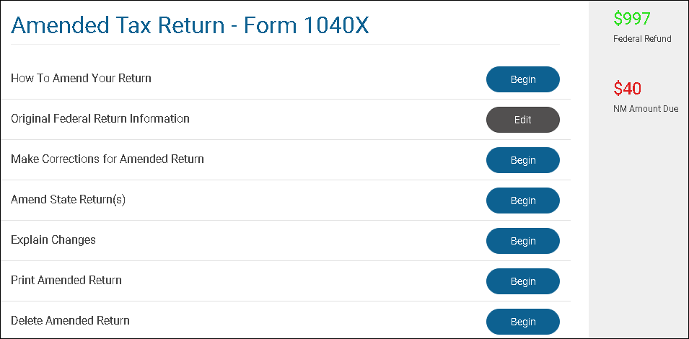
Amending in TaxSlayer
Notes:
Select: Make Corrections for Amended Return
IF return prepared at your site and original information already in TaxSlayer select: Continue and proceed to Federal section to enter the $100 additional interest received (or all changes)
If original return NOT prepared at your site, select: Continue and proceed to Federal section. Enter all original tax information and match taxpayer’s return to TaxSlayer.
Once matched, enter additional $100 additional interest (or all changes)

Slide 18
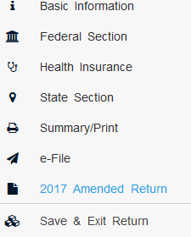
Amending in TaxSlayer
After entering $100 additional interest received, return to Amended Return

Slide 19
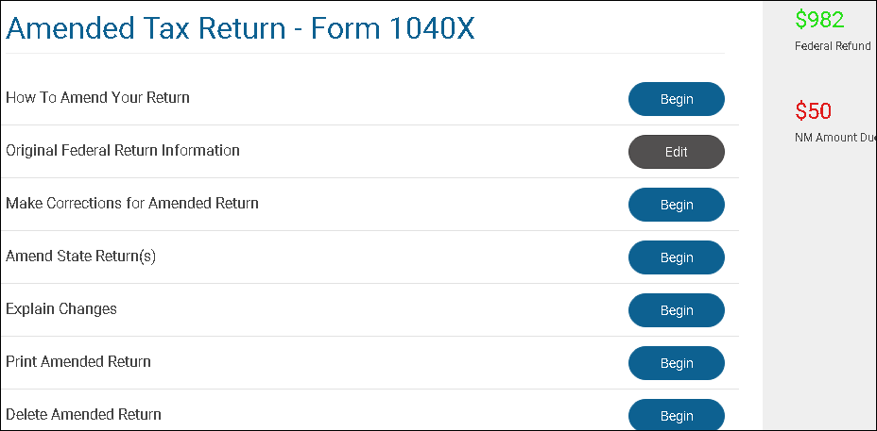
Amending in TaxSlayer
Notes:
Print out page 1 of Form 1040X to see and explain all line changes

Slide 20
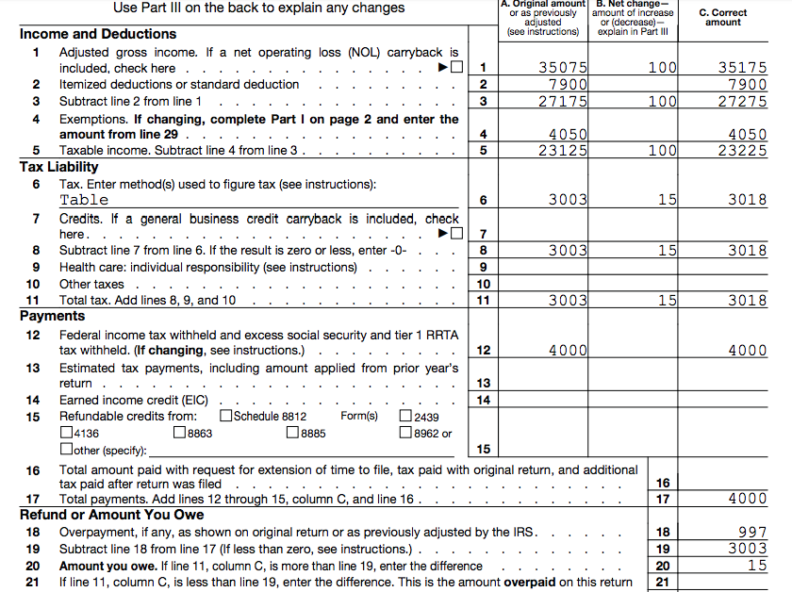
Amending in TaxSlayer
Print page 1 Form 1040X and explain all line changes

Slide 21
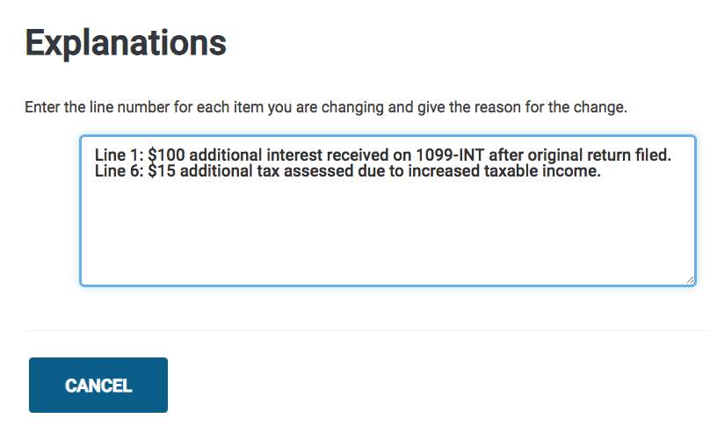
Amending in TaxSlayer
Notes:
Line numbers not required however each line change must be explained. An increase in income that also increases taxable social security income must be explained to prevent additional IRS correspondence.

Slide 22
Printing Amended Return
Print Form 1040X and all new and any changed forms or schedules
Two copies and one if needed for state
Print from Amended Tax Return – Form 1040X screen
Generally, do not include new Form 1040 in print packet unless required by state
If included mark at bottom “As Amended”
Notes:
For example: If 1040X includes Schedule A itemized deductions with medical expenses, include a copy of Schedule A in packet if AGI has changed

Slide 23
Assembling Amended Return
Attach new and corrected tax documents
W-2, W-2G, or 1099-R (if tax withholding)
Attach all new and changed forms and schedules
Include supporting documents, worksheets, etc. in taxpayer’s copy only

Slide 24
Filing Amended Return
Provide taxpayer with 1040X IRS mailing address
No cover letter required
Taxpayer/spouse sign and date copy to be mailed
Provide taxpayer copies for their records
Notes:
http://www.irs.gov/pub/irs-pdf/i1040x.pdf … url for 1040X Instructions
1040X must be mailed – find IRS address in TaxSlayer or print Page 5 (“Where to File”) of 1040X instructions

Slide 25
Amendment – Refund
Original return refund received on normal IRS schedule
IRS.gov “Where’s My Refund”
1040X refund received within 8 to 12 weeks
After 12 weeks, contact IRS 800-829-1040
Refunds cannot be direct deposited
IRS check mailed to address on 1040X may include interest

Slide 26
Amendment – Balance Due
Balance due with prior year amendment:
Taxpayer should file 1040X as soon as possible
Include payment to reduce penalty and interest
IRS will send letter with penalty and interest assessed
Do not include 1040-V (voucher)
Pay amount due on 1040X Page 1
Notes:
The Form 1040X serves as the voucher.

Slide 27
Amending State Return
When state only amendment required
Amend federal and file with explanation of “Information Only: Changes did not impact the federal return however the return has been amended for state purposes”
Follow state specific rules for amending state returns
Notes:
Federal 1040X required by some states even though no changes
Insert state slides here

Slide 28
Quality Review
Verify column A of Form 1040X agrees with last determined return
Confirm needed changes properly made
Verify tax re-computed properly
Add TaxSlayer Tag and “Note” to document when and why amended return prepared
Notes:
The Amended Tag is a great search tool for EROs and LCs for reporting.

Slide 29
Taxpayer Summary
Review amended return with taxpayer
Verify taxpayer understands how to file amendment
Sign, address envelope, additional postage may be required
If payment required, include with return
Verify taxpayer aware of filing due date

Slide 30
Amended or Prior Year Returns
Comments ...
Questions?

